Slide 1
Software Security
Lecture 1
Friday February 14, 2020

Slide 2
Introduction

Slide 3
What is Cyber Security?
Highly Technical
People, processes, and technology
Legislation and Regulation
Risk management
Notes:
Cyber-security is the practice of defending computers, servers, mobile devices, electronic systems, networks, and data from malicious attacks
Cyber security is the state or process of protecting and recovering networks, devices and programs from any type from malicious attacks.

Slide 4
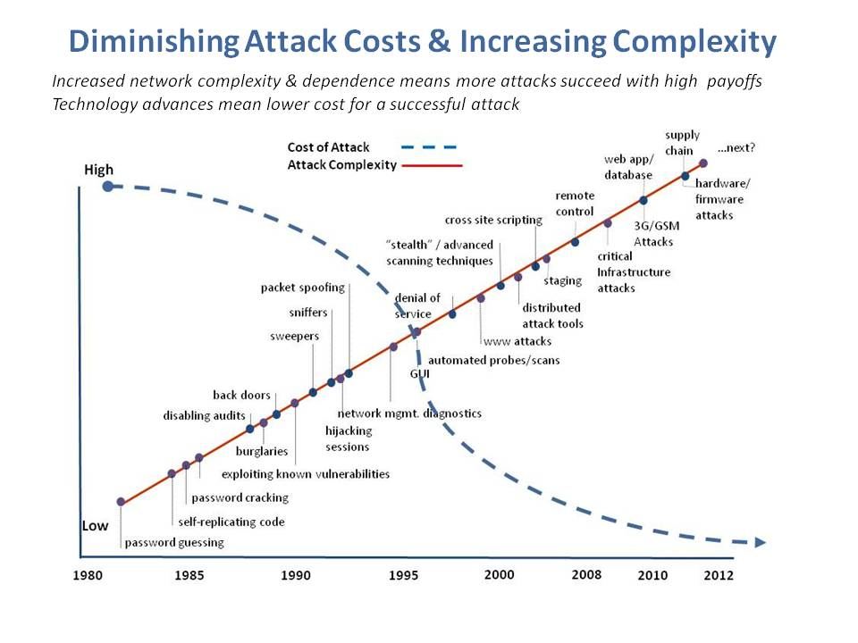
Copyright of Information Security Incorporated © 2008–2014

Slide 5
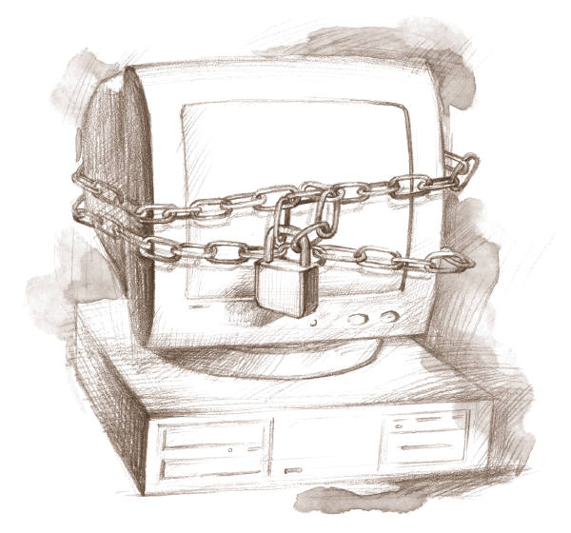
What Can I Do?
Notes:
What can I do to protect myself from cyberattacks?
Should I stay disconnected?

Slide 6
Class Information
Class Homepage: https://drive.google.com/open?id=1C8cUOSzTX5NEQrwhSV0zvdsoeDtDO9Dt
Instructor: Dr. Emad Alsuwat
Office: W109
Office Hours: Tuesday 8:00 am – 10:00 am
E-mail: Alsuwat@tu.edu.sa or Alsuwat@live.com

Slide 7
Textbooks
Software Security – Building Security In, Author: Gary McGraw, ISBN:0321356705
24 Deadly Sins of Software Security by Michael Howard, David LeBlanc, John Viega, Publisher: McGraw-Hill Osborne Media
Software Security Principles, Policies, and Protection, Mathias Payer May 2018

Slide 8
Course Objective
Understand the challenges of insecure and vulnerable software
Investigate the types of threats and vulnerabilities inherent in software
Understand risk management framework
Study secure coding concepts and techniques
Gather knowledge of secure software design and development
Learn software security in enterprise business

Slide 9
Assignments
Homework assignments and labs: There will be several homework assignments during the semester. In addition to homework assignments, there will be several hands-on experiments. The focus of these experiments is practical with discussions on why and how mechanisms ensure security, what level of security is provided, and how hostile adversaries might violate the mechanisms.
Midterm exam: The midterm exam is a closed book test which covers the course material.

Slide 10
Assignments
Research project: There will be one research project related to software security. Final project reports must be submitted at the end of the semester. Further project requirements will be distributed at a later time.
Final exam: The final exam is a closed book test and accumulative.
Assignments are always due on the announced day and time. There will be a late submission penalty of 10% per day after the due date for homework and project assignments.

Slide 11
Grading
Participation and Quizzes 5%
Homework assignments and labs: 30%
Research project : 10% Bonus 5%
Midterm exam: 20%
Final exam: 35%

Slide 12
Introduce yourself

Slide 13
Your name
Current carrier
Your goal (why Master in Cybersecurity)
Your plan after completing your studies

Slide 14
Basic Security Concepts

Slide 15
Security Objectives
Confidentiality: prevent/detect/deter improper disclosure of information
Integrity: prevent/detect/deter improper modification of information
Availability: prevent/detect/deter improper denial of access to services

Slide 16
Military Example
Confidentiality: target coordinates of a missile should not be improperly disclosed
Integrity: target coordinates of missile should be correct
Availability: missile should fire when proper command is issued

Slide 17
Commercial Example
Confidentiality: patient’s medical information should not be improperly disclosed
Integrity: patient’s medical information should be correct
Availability: patient’s medical information can be accessed when needed for treatment

Slide 18
Quiz
Give an educational example for each one of the main security objectives.
Confidentiality
Integrity
Availability

Slide 19
Fourth Objective
Securing computing resources: prevent/detect/deter improper use of computing resources
Hardware
Software
Data
Network

Slide 20
Question 1: What is the trade off between the security objectives?
Confidentiality reduces integrity because secret data is higher quality
Integrity requires that the data is kept in an isolated location and cannot be accessed
Increased confidentiality may reduce availability
Confidential and correct data has high trade off availability

Slide 21
Achieving Security
Organizational Goals
Why to invest in security protection?
Policy
What to protect?
Mechanism
How to protect?
Assurance
How good is the protection?

Slide 22
Security Policy
Organizational
Policy
MUST fit the security policy into the organizational policy
Computerized
Information System
Policy

Slide 23
Question 2: Why do we need to fit the security policy into the organizational policy?
Because the management would not pay for it otherwise
Because security policy should support and protect organizational goals
Because this will make the implementation easier
Because it is mandated by law and regulation

Slide 24
Security Mechanism
Prevention
Detection
Tolerance/Recovery
Notes:
What are the main goals of security?

Slide 25
Security by Obscurity
Hide inner working of the system
Bad idea!
The National Institute of Standards and Technology (NIST) in the United States sometimes recommends against this practice
“System security should not depend on the secrecy of the implementation or its components.”
The technique stands in contrast with security by design
Notes:
Security by obscurity alone is discouraged and not recommended by standards bodies.
The National Institute of Standards and Technology (NIST) in the United States sometimes recommends against this practice:
"System security should not depend on the secrecy of the implementation or its components.”

Slide 26
Security by Legislation
Instruct users how to behave
Not good enough!
Important
Only enhance security
Targets only some of the security problems

Slide 27
Security Tradeoffs
Security
Functionality
COST
Ease of Use

Slide 28
Threat, Vulnerability, Risk
Threat: potential occurrence that can have an undesired effect on the system
Vulnerability: characteristics of the system that make it possible for a threat to potentially occur
Attack: action of malicious intruder that exploits vulnerabilities of the system to cause a threat to occur
Risk: measure of the possibility of security breaches and severity of the damage

Slide 29
Types of Threats (1)
Errors of users
Natural/man-made/machine disasters
Dishonest insider
Disgruntled insider
Outsiders
Notes:
Discontent

Slide 30
Types of Threats (2)
Disclosure threat – dissemination of unauthorized information
Integrity threat – incorrect modification of information
Denial of service threat – access to a system resource is blocked

Slide 31
Types of Attacks (1)
Interruption – an asset is destroyed, unavailable or unusable (availability)
Interception – unauthorized party gains access to an asset (confidentiality)
Modification – unauthorized party tampers with asset (integrity)
Fabrication – unauthorized party inserts counterfeit object into the system (authenticity)
Denial – person denies taking an action (authenticity)

Slide 32
Types of Attacks (2)
Passive attacks:
Eavesdropping
Monitoring
Active attacks:
Masquerade – one entity pretends to be a different entity
Replay – passive capture of information and its retransmission
Modification of messages – legitimate message is altered
Denial of service – prevents normal use of resources

Slide 33
Computer Crime
Any crime that involves computers or aided by the use of computers
U.S. Federal Bureau of Investigation: reports uniform crime statistics

Slide 34
Malicious Attacks
Method: skills, knowledge, tools, information, etc.
Opportunity: time and access
Motive: reason to perform the action
Notes:
Malicious users must have three things to succeed: motivation, opportunity, method, explain each one of them.

Slide 35
Computer Criminals
Amateurs: regular users, who exploit the vulnerabilities of the computer system
Motivation: easy access to vulnerable resources
Crackers: attempt to access computing facilities for which they do not have the authorization
Motivation: enjoy challenge, curiosity
Career criminals: professionals who understand the computer system and its vulnerabilities
Motivation: personal gain (e.g., financial)

Slide 36
Methods of Defense
Prevent: block attack
Deter: make the attack harder
Deflect: make other targets more attractive
Detect: identify misuse
Tolerate: function under attack
Recover: restore to correct state

Slide 37
Information Security Planning
Organization Analysis
Risk management
Mitigation approaches and their costs
Security policy
Implementation and testing
Security training and awareness

Slide 38
Software Security

Slide 39
Why Software Security?
Software is essential in almost every aspect of our life
Most software systems today contain numerous flaws and bugs that get exploited by attackers
New threats emerge everyday
Exponential increase in vulnerabilities in software systems
Programmers have a long history of repeating the same security-related mistakes

Slide 40
Software Security
“Idea of engineering software so that it continues to function correctly under malicious attack”
Functional requirements
Non-functional requirements
Software security is NOT security software

Slide 41
Software Problem
More than half of the vulnerabilities are due to buffer overruns
Others such as race conditions, design flaws are equally prevalent
# of vulnerabilities reported by CERT/CC
Notes:
The CERT Coordination Center (CERT/CC) is the coordination center of the computer emergency response team (CERT) for the Software Engineering Institute (SEI), a non-profit United States federally funded research and development center.

Slide 42
Software Security
It is about
Understanding software-induced security risks and how to manage them
Leveraging software engineering practice,
Thinking security early in the software lifecyle
Knowing and understanding common problems
Designing for security
Subjecting all software artifacts to thorough objective risk analyses and testing
It is a knowledge intensive field

Slide 43
Security problems in software
Defects are implementation vulnerabilities and design vulnerabilities.
Bugs are implementation-level errors that can be detected and removed.
Example: Buffer overflow.
Flaws are problems at a deeper level. They are instantiated in the code and present or absent at design-level.
Example: Error-handling problems.
Failures are the inability of the software to perform its required function.

Slide 44
Security problems in software
Risks capture the probability that a flaw or a bug will impact the purpose of the software.
Vulnerabilities are errors that an attacker can exploit.
Either flaws in the design or flaws in the implementation.
Design-level vulnerabilities are the hardest defects to handle.

Slide 45
Pillars of Software Security
The three pillars of software security

Slide 46
Pillar I: Risk Management
A continuous risk management process is an essential part to software security
It identifies, ranks, tracks, and understands software security risks
Risk Management Framework (RMF)
An overall approach to risk management.
Allows a consistent and continuous expertise-driven approach to risk management.
The goal is to consistently track and handle risks
Tracking and mitigating risks throughout the full SDLC

Slide 47
Pillar II: Touchpoints
Security touchpoints are set of security best practices
System-wide activity: from design to testing and feedback
Seven touchpoints (in order of effectiveness)
Code review
Architectural risk analysis
Penetration testing
Risk-based security tests
Abuse cases
Security requirements
Security operations

Slide 48
Pillar III: Knowledge
Involves gathering, encapsulating, and sharing security knowledge.
Software Security Knowledge Catalogs:
Principles.
Guidelines.
Rules.
Vulnerabilities.
Exploits.
Attack Patterns.
Historical Risks.
Can be put into three categories
Prescriptive knowledge
Diagnostic knowledge
Historical knowledge

Slide 49
Questions?

